Slide 1

SCREEN GRAPHICS OF FLORIDA
Customer Service Inquiry
Training Guide
HarrisData EIP · SG Inquiries › Order Entry · June 2026
portal.screen-graphics.com:5601/EIP
Notes:
Welcome to the Customer Service Inquiry training guide for the HarrisData EIP portal at Screen Graphics of Florida. This guide will walk you through how to search for customer orders and access detailed information about orders, invoices, manufacturing orders, and items. Let's get started.

Slide 2
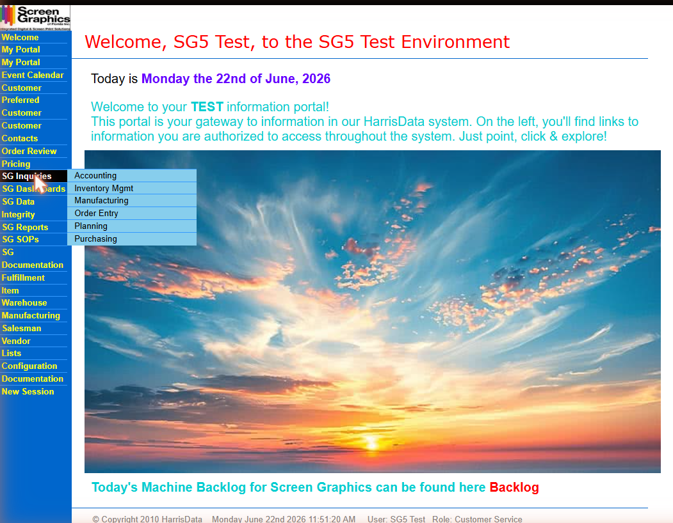
1
Log In & Navigate to SG Inquiries
1. Go to: portal.screen-graphics.com:5601/EIP
2. Log in, locate SG Inquiries in the left menu.
3. Hover → click Order Entry.
⚠ EIP menus vary by role. If you don't see SG Inquiries, contact your supervisor
Fig. 1 — Hover over SG Inquiries to reveal the submenu
Notes:
To access the Customer Service Inquiry, open your browser and navigate to the EIP portal at portal.screen-graphics.com, port 5601, slash EIP. After logging in, look for the SG Inquiries option in the left navigation menu. Hover your mouse over SG Inquiries and a submenu will appear. Click Order Entry from that submenu. Note that your EIP menu may look different from what you see here, depending on the role assigned to your account. If you do not see SG Inquiries in your menu, contact the IT department to have it added.

Slide 3
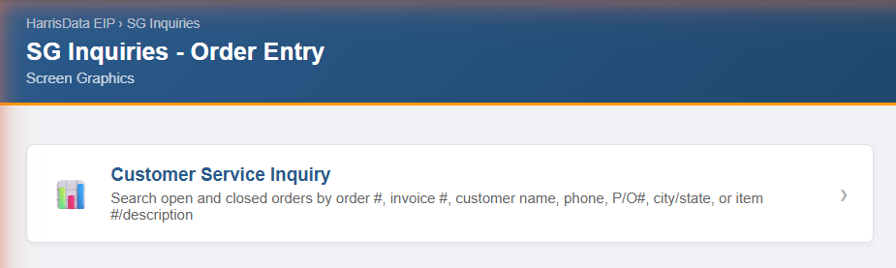
2
Open Customer Service Inquiry
Clicking Order Entry opens the SG Inquiries — Order Entry landing page. Click the Customer Service Inquiry tile.
Search fields:
Order #, Invoice #, name, phone, P/O#, city/state, item #/description
Fig. 2 — Order Entry landing page
Notes:
Clicking Order Entry opens the SG Inquiries Order Entry landing page. You will see a single tile labeled Customer Service Inquiry. The description below it confirms what you can search: order number, invoice number, customer name, phone, purchase order number, city and state, or item number and description. Click this tile to open the search screen.

Slide 4
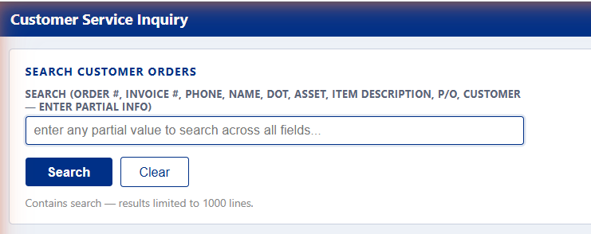
3
The Search Screen
Enter any partial value to search across all fields at once:
Field | Example
Order # | 353943
Invoice # | 21659
Phone | 904-827
Name | FCC ST JOHNS
DOT | 1197391
Asset | UNIT# 20020
Item Desc | ROLLOFF
P/O | 4610131092
Customer # | 3092110
⚠ Results limited to 1,000 lines. Use a more specific value if needed.
Fig. 3 — Customer Service Inquiry search screen
Notes:
The Customer Service Inquiry search screen has a single search box that searches across all fields simultaneously. You can search by order number, invoice number, phone number, customer name, D-O-T number, asset number, item description, purchase order number, or customer number. Simply type any partial value — you do not need to know the exact full value — and click Search. Results are limited to one thousand lines, so use a more specific search term if you get too many results. Use the Clear button to reset the search box.

Slide 5
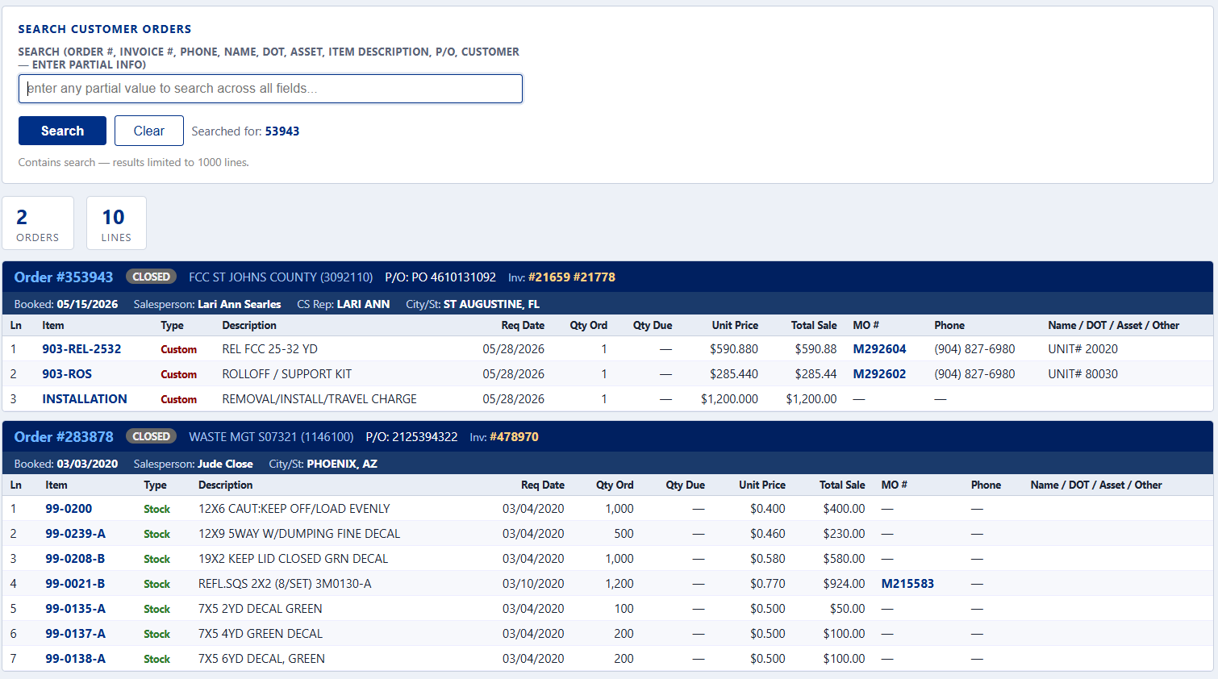
4
Reading the Search Results
Results are grouped by order. Clickable fields open a new window:
Field | Description
Order # | Opens full order detail
Customer # | Opens customer record
Inv # | Opens the invoice
Item # | Opens item record
MO # | Opens manufacturing order
Status | OPEN or CLOSED
P/O | Purchase order number
Booked | Date order was entered
Slsp / CS Rep | Salesperson & CS rep
Fig. 4 — Search results with orders and line items
Notes:
Search results are grouped by order. At the top you will see a count of total orders and lines found. Each order header bar shows the order number, customer name and number, purchase order number, invoice numbers, booked date, salesperson, customer service rep, and city and state. Below each header are the line items for that order, showing the item number, item type, description, required date, quantities, pricing, manufacturing order number, phone number, and reference fields. Five fields are clickable and will each open a new browser window: the Order number opens the full order detail, the Customer number opens the customer record, Invoice numbers open the invoice, Item numbers open the item record, and M-O numbers open the manufacturing order detail. Prices highlighted in yellow indicate a special or overridden price.

Slide 6
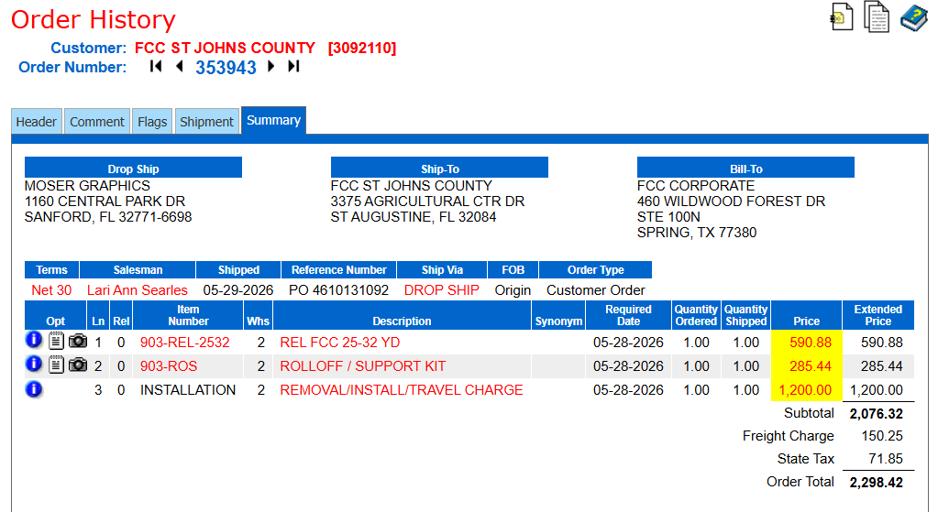
5
Order Detail — Order, Open or History
Click any Order # to open the full Order History in a new window:
Tab | Contents
Header | Dates, terms, ship method
Comment | Order notes
Flags | Special flags
Shipment | Tracking info
Summary | Addresses, lines, totals
Fig. 5 — Order History Summary tab
Notes:
Clicking an order number opens the Order History detail in a new browser window. The order detail has five tabs at the top. The Header tab shows order dates, terms, salesperson, ship method, and order type. The Comment tab shows any order-level notes. The Flags tab shows special flags set on the order. The Shipment tab shows shipment and tracking information. The Summary tab, which is the default view, shows the Drop Ship, Ship-To, and Bill-To addresses, all line items with quantities and pricing, and the order totals including subtotal, freight charge, state tax, and order total. Prices highlighted in yellow indicate a special or overridden price. Use the navigation arrows next to the order number to move to the previous or next order for the same customer.

Slide 7
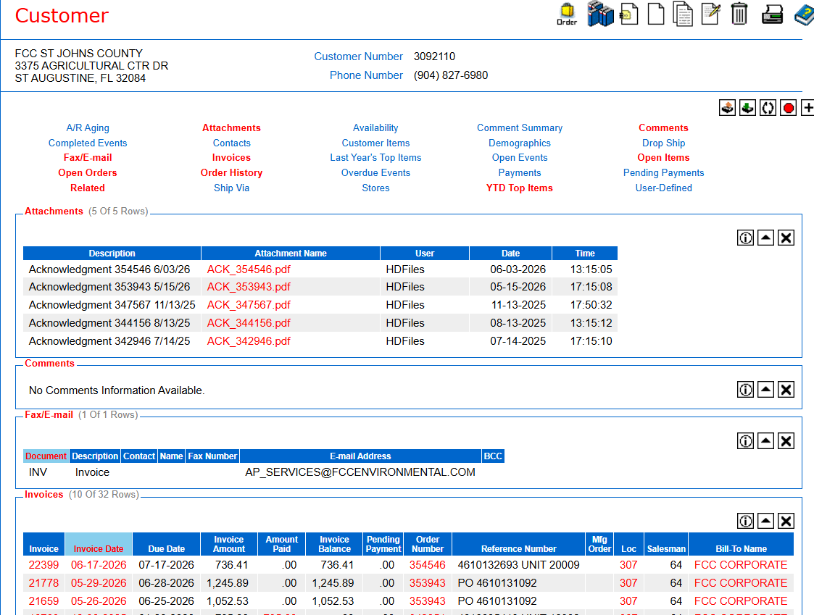
6
Customer Record
Click the customer number in any order header to open their full record in a new window.
Available from the customer page:
A/R Aging, Open Orders, Order History
Invoices & Pending Payments
Attachments, Comments, Fax/E-mail
Customer Items, YTD Top Items
Availability, Demographics, Contacts
Drop Ship, Open Items, User-Defined
Fig. 6 — Customer home page
Notes:
Clicking the customer number in any order header opens that customer's full record in a new browser window. The customer home page is a comprehensive view of everything related to that customer. From here you can access their A-R Aging, Open Orders, and Order History. You can view their Invoices and Pending Payments. You can also access Attachments, Comments, and Fax and Email information. Additional sections include Customer Items, Y-T-D Top Items, Last Year's Top Items, Availability, Demographics, Contacts, Events, Drop Ship records, Open Items, and User-Defined fields.

Slide 8
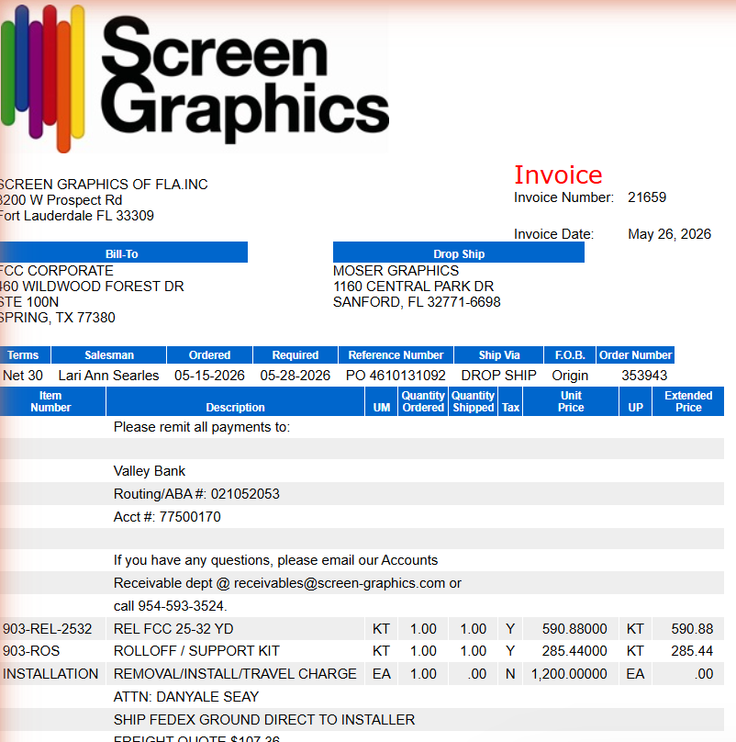
7
View an Invoice
Click any Invoice # in the results or on the customer page to open the full invoice in a new window.
The invoice includes:
Bill-To and Drop Ship addresses
Terms, salesperson, dates
Reference #, ship via, order #
Line items with quantities & pricing
Payment & remit-to information
Fig. 7 — Invoice detail
Notes:
Clicking an invoice number opens the full invoice in a new browser window. The invoice displays the Screen Graphics logo and company address at the top. It shows the Bill-To and Drop Ship addresses, along with terms, salesperson, order date, required date, reference number, ship method, F-O-B, and order number. The line items are listed with quantities ordered, quantities shipped, unit price, and extended price. At the bottom you will find payment instructions including the remit-to bank information and the accounts receivable contact.

Slide 9
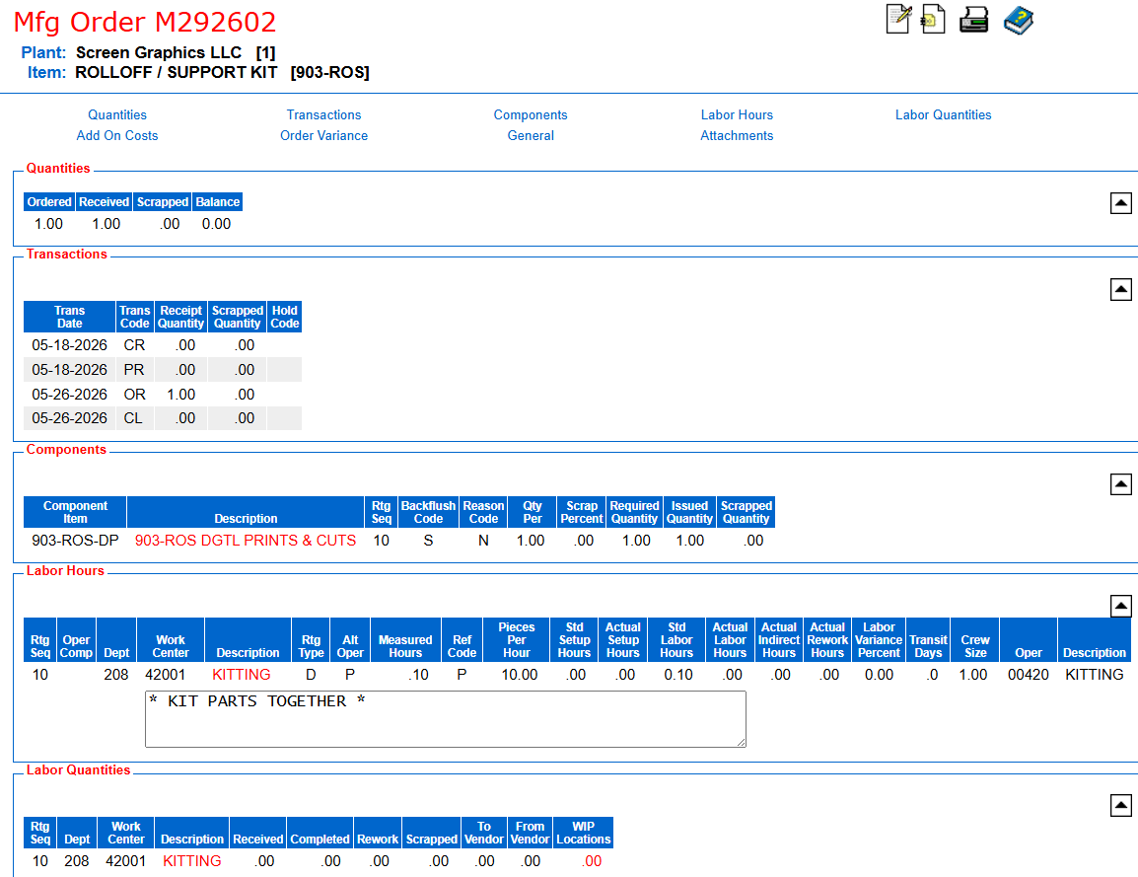
8
View a Manufacturing Order
Click any MO # in the search results to open the Manufacturing Order detail in a new window.
The MO detail shows:
Item being produced and plant
Quantities: Ordered, Received, Scrapped, Balance
Transaction history with dates & codes
Components / bill of materials
Labor Hours and routing operations
Labor Quantities by dept & work center
Fig. 8 — Manufacturing Order detail
Notes:
Clicking an M-O number opens the Manufacturing Order detail in a new browser window. At the top you will see the M-O number, the item being produced, and the plant. The Quantities section shows how many were ordered, received, scrapped, and the remaining balance. The Transactions section shows the history of transactions on the order with dates and transaction codes. The Components section shows the bill of materials — the component items required to produce this product. The Labor Hours section shows the routing operations, work centers, standard and actual hours. The Labor Quantities section shows actual labor reported by department and work center.

Slide 10
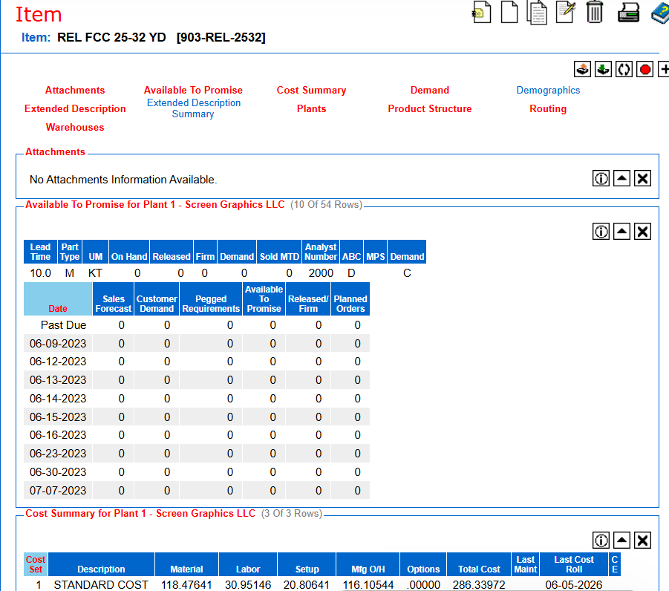
9
View an Item Record
Click any Item # in the search results to open the full item record in a new window.
The item record includes:
Item number, description, unit of measure
Available to Promise — demand by date
Cost Summary — material, labor, total cost
Demand, Product Structure, Routing
Warehouses, Plants, Demographics
Attachments & Extended Descriptions
Fig. 9 — Item record detail
Notes:
Clicking an item number opens the full item record in a new browser window. At the top you will see the item number and description. The Available to Promise section shows current inventory, demand, sales forecasts, customer demand, and planned orders by date — this tells you whether the item is available to ship. The Cost Summary shows the standard cost broken down into material, labor, setup, manufacturing overhead, and total cost, along with the last maintenance date. Additional tabs give access to Demand, Product Structure, Routing, Warehouses, Plants, Demographics, Attachments, and Extended Descriptions.

Slide 11
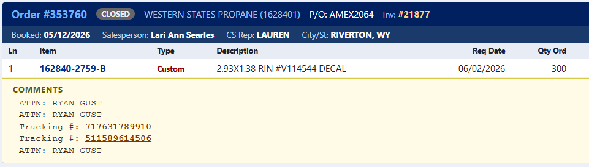
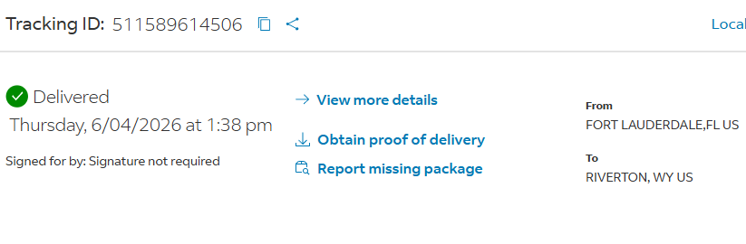
10
FedEx Tracking — Click to Track
When a FedEx tracking number appears in an order’s Comments tab, it displays as a clickable link that opens FedEx tracking in a new window.
How it works:
Open the order and click the Comment tab in Order History.
FedEx tracking numbers appear as blue underlined links.
Click the number to open FedEx tracking in a new window.
FedEx shipments only — other carriers will not show a link.
Fig. 10 — FedEx tracking numbers as clickable links in order Comments

Slide 12
Questions?
Contact Screen Graphics IT for training or support.
sgit@screen-graphics.com
800-346-4420
screen-graphics.com
3200 W. Prospect Rd. · Fort Lauderdale, FL 33309
Notes:
That concludes the Customer Service Inquiry training guide. If you have questions, need access to the EIP portal, or require additional training, please contact the IT department. You can reach us by email at S-G-I-T at screen-graphics dot com, or by phone at 800-346-4420. Thank you for watching.

